Slide 1



Introduction to Quantum

Slide 2
Agenda
What is Quantum?
The Test Scenario – introducing BDD optional
Jumping in – Writing a test scenario with pre-defined steps
Digging deeper
Running tests with TestNG
Application properties
Assignment – Writing my first Quantum scenario
Notes:
Welcome to our course on Quantum, Perfcto’s automation framework.
This module introduces the course and we’ll jump straight into today’s agenda.
We’ll learn what Quantum is and the different flavours of Quantum and then look at the BDD (Behaviour driven design layer) and learn how it works.
After that we’ll show a demo of a BDD script
For the demo we’ll show how a script is run in Quantum and show how to configure the application properties and testing file.

Slide 3
What is Quantum
Background
Open source, standards based automation framework
Sponsored by Perfecto
Features
Easy setup - lab access, driver management.
Test creation - BDD for easy-to-use English phrased steps using standard Cucumber
Result analysis - Perfecto Reporting incorporated into the test
Data driven testing (xml, csv, db)
Devices management mechanism including smart wait
Perfecto commands as Java and Cucumber utils
Notes:
Quantum is designed to give a team everything it needs.
Easy test creation with BDD steps
Custom step creation
Built in execution, reporting, and data modules.
Ready to go with a simple setup.
In this course we'll cover everything, beginning today with a simple test scenario and ending in advanced features.

Slide 4
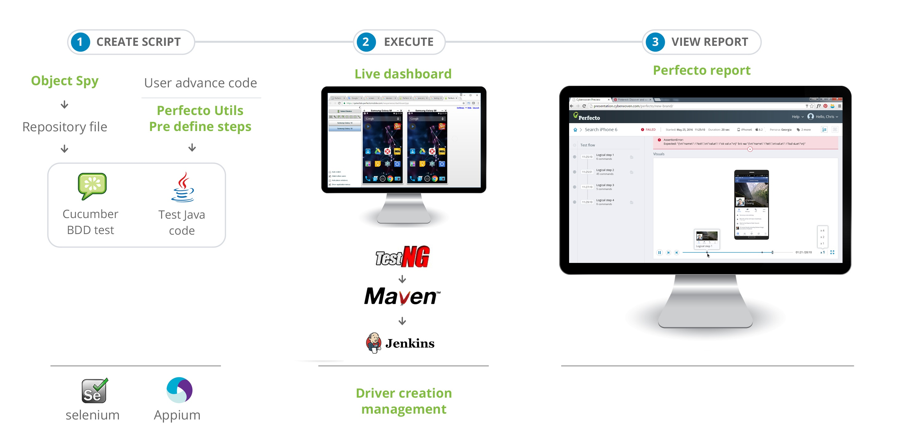
Quantum Overview
Notes:
We can see the entire flow here from writing to execution.
Selenium & Appium Tests are written in BDD or Java using the Object spy and Quantum’s utilities. The test is executed from testing and can be viewed live in the Device Dashboard and finally a full report is available at the end of the test.
The Selenium, Perfecto commands, TestNG & Maven are all provided pre-built by Quantum.

Slide 5
Quantum Users
Testers
Automation testers.
Understand testing and flows
Able to write BDD tests.
Test Developers
Know basic Java
Able to implement custom steps.
Can’t create full project (Java, Maven ,TestNG)
Developers
Advance Java developer
Able to extend Quantum.
Notes:
Quantum is designed for a team with a range of abilities.
Testers can write tests using BDD steps and do not need to know Java
Test Developers who know some Java can write custom steps tailored to their application and flows.
Developers can extend Quantum, connect to CI and create any proprietary features are required.

Slide 6
Quantum Flavors
The BDD layer of Quantum is optional and has the following value:
Clarity & simplicity in Steps any user can understand.
Enables users who are not developers to write scenarios with existing steps.
Easy to read steps appear in reports and make them user friendly.
Teams which are wholly composed of Java developers can decide to forgo this layer and use Quantum with pure Java only.
Notes:
This course displays Quantum with BDD. If you feel you will be better off with a “pure Java” implementation please discuss this with your trainer who will be able to advise you on pros and cons and provide the relevant training material.

Slide 7
Quantum Git Resources
Quantum is freely downloadable from Git contains multiple resources:
Training course – contains all the samples referred to in this course https://github.com/Project-Quantum/Training-Course
Starter Kit – A full working version to start with - https://github.com/Project-Quantum/Quantum-Starter-Kit
Training Assignments - https://github.com/Project-Quantum/TrainingAssignments
The Entire project - https://github.com/Project-Quantum contains several repos of samples
Notes:
Quantum is available for free from Github.
In this course we will use the training course repo that contains all the samples which we will be referring to. This repo contains everything in the starter kit plus a series of samples designed for this course.
The assignments repo contains the answers to the assignments, try not to look at it ☺
For starting a new automation project, the starter kit is recommended to use.
The Quantum project contains other repos with samples and snippets you are welcome to use.
Once again, download the training course repo for this course.

Slide 8

2. The Test Scenario – introducing BDD

Slide 9
What is BDD (Behavior-Driven Development )
Quantum uses BDD scenarios to write test.
Utilizing the Gherkin language this allows us to define steps that have a human logic e.g.. "I Login to application" and to re-use these steps.
Steps are divided into pre-defined steps, provided out of the box with Quantum and custom steps which are implemented in Java.
The best practice is to create custom steps for most cases.
Notes:
The idea of BDD is to write our test in steps that make sense in a clear and “human” language.
We can name our steps as we want and add logical prefixes like And, When, Then to the step.
The end result is readable and easy to understand.
Quantum provides many steps out of the box, we call these pre-defined steps. We can also extend this and write our own steps which are called custom steps. This is the best practice that leverages our time the best, when we define a step e.g. login to application we can then re-use it in all the relevant tests.
The steps are written in the Gherkin language and later on implemented in Java. We will be showing both types of steps in this course. In this module, we will begin with the pre-defined steps.

Slide 10
Feature Structure
A line starting with the keyword Feature
followed by free indented text starts a feature.
A feature usually contains a list of scenarios.
You can write whatever you until the first scenario, which starts with the word on a new line.
Convention:
Single Gherkin source file contains a description of a single feature.
Source files have .feature extension.
Notes:
Each test suite we write is called in Cucumber a feature.
A feature can contain multiple scenarios which are the actual tests being run.
The feature and scenario descriptions are important and allow you to know exactly what you are testing. Scenarios under a feature should make sense i.e. they should all relate to the same functionality or flow.
Our files will have a .feature extension.

Slide 11
Scenarios
Every scenario consists of a list of steps, which must start with one of the keywords Given, When, Then, But or And. Cucumber treats them all the same, but you shouldn’t. Here is an example:
Feature: Serve coffee
Coffee should not be served until paid for
Coffee should not be served until the button has been pressed
If there is no coffee left then money should be refunded
Scenario: Buy last coffee
Given there are 1 coffees left in the machine
And I have deposited 1$
When I press the coffee button
Then I should be served a coffee
Notes:
Let’s look at a sample that has a Feature and under it a scenario.
As you can see, the feature has a name and is followed by as few lines of a description which is free text that tells you what it is that is about to be tested in the scenario.
The steps in the scenario begin with keywords: And, Then, when Given.
Technically this does not matter, they will all be executed the same. The keywords give us the ability to construct a scenario that makes sense. Clarity and common sense are the benefits of the BDD language so we need to make sure we use it correctly to gain these benefits.
We’ll now loot a bit closer at the keywords.

Slide 12
Steps - Given When Then
Given - Put the system in a known state before the user (or external system) starts interacting with the system.
When - describe the key action the user performs
Then - The purpose of Then steps is to observe outcomes. The observations should be related to the business value/benefit in your feature description. The observations should also be on some kind of output – that is something that comes out of the system (report, user interface, message) and not something that is deeply buried inside it (that has no business value).
Notes:
Given
The purpose of givens is to put the system in a known state before the user (or external system) starts interacting with the system (in the When steps). Avoid talking about user interaction in givens. If you were creating use cases, givens would be your preconditions.
Examples:
Create records (model instances) / set up the database state.
It’s ok to call into the layer “inside” the UI layer here (in Rails: talk to the models).
Log in a user (An exception to the no-interaction recommendation. Things that “happened earlier” are ok).
And for all the Rails users out there – we recommend using a Given with a multiline table argument to set up records instead of fixtures. This way you can read the scenario and make sense out of it without having to look elsewhere (at the fixtures).
When
The purpose of When steps is to describe the key action the user performs (or, using Robert C. Martin’s metaphor, the state transition).
Examples:
Interact with a web page (Webrat/Watir/Selenium interaction etc should mostly go into When steps).
Interact with some other user interface element.
Developing a library? Kicking off some kind of action that has an observable effect somewhere else.
Then
The purpose of Then steps is to observe outcomes. The observations should be related to the business value/benefit in your feature description. The observations should also be on some kind of output – that is something that comes out of the system (report, user interface, message) and not something that is deeply buried inside it (that has no business value).
Examples:
Verify that something related to the Given+When is (or is not) in the output
Check that some external system has received the expected message (was an email with specific content sent?)
While it might be tempting to implement Then steps to just look in the database – resist the temptation. You should only verify outcome that is observable for the user (or external system) and databases usually are not.

Slide 13
Make Scenario Readable – using Ands & Buts
When you have several givens, whens or thens make it more readable and fluent by using ands and buts
Scenario: Multiple Givens
Given one thing
Given another thing
Given yet another thing
When I open my eyes
Then I see something
Then I don't see something else
Scenario: Multiple Givens
Given one thing
And another thing
And yet another thing
When I open my eyes
Then I see something
But I don't see something else
Notes:
And, But
If you have several givens, whens or thens you can replace them with Ands and Buts and make it read more fluently by writing
Scenario: Multiple Givens Given one thing And another thing And yet another thing When I open my eyes Then I see something But I don't see something else
To Cucumber steps beginning with And or But are exactly the same kind of steps as all the others.

Slide 14
Background
Background allows you to add some context to the scenarios in a single feature. A Background is much like a scenario containing a number of steps. The difference is when it is run. The background is run before each of your scenarios but after any of your Before Hooks.
Use complicated state only if necessary
Keep it short
Make it vivid
Feature: Multiple site support
As a Mephisto site owner
I want to host blogs for different people
In order to make gigantic piles of money
Background:
Given a global administrator named "Greg"
And a blog named "Greg's anti-tax rants"
And a customer named "Dr. Bill"
And a blog named "Expensive Therapy" owned by "Dr. Bill"
Scenario: Dr. Bill posts to his own blog
Given I am logged in as Dr. Bill
When I try to post to "Expensive Therapy"
Then I should see "Your article was published."
Notes:
In addition to a scenario, a feature may contain a background, scenario outline and examples. Respective keywords (in English) and places to read more about them are listed below. You can get a list of localized keywords with
Background allows you to add some context to the scenarios in a single feature. A Background is much like a scenario containing a number of steps. The difference is when it is run. The background is run before each of your scenarios but after any of your Before Hooks.
Good practices for using Background
Don’t use “Background” to set up complicated state unless that state is actually something the client needs to know.
For example, if the user and site names don’t matter to the client, you should use a high-level step such as “Given that I am logged in as a site owner”.
Keep your “Background” section short.
You’re expecting the user to actually remember this stuff when reading your scenarios. If the background is more than 4 lines long, can you move some of the irrelevant details into high-level steps? See Calling Steps from Step Definitions.
Make your “Background” section vivid.
You should use colorful names and try to tell a story, because the human brain can keep track of stories much better than it can keep track of names like “User A”, “User B”, “Site 1”, and so on.
Keep your scenarios short, and don’t have too many.
If the background section has scrolled off the screen, you should think about using higher-level steps, or splitting the *.features file in two.

Slide 15

3. Jumping in – Writing a test scenario with pre-defined steps
Notes:
We’ll now open Quantum and show a demo of executing a sample feature.
Remember to download the training course repo from GitHub if you want to try this out for yourself.

Slide 16

Jumping In – Writing a test scenario
We are going to write a test scenario together
Our test will:
Go to Wikipedia
Validate the homepage has loaded
Search for "Apple"
Validate that we have reached the right page. The fruit, not the company.
Notes:
First we’ll peek at what our test actually does.
It tests the Wikipedia site by going to the homepage, validating that the home page has loaded and then it enters a search term and checks the result.
Now, let’s see how that looks in Quantum.
Open the IDE and start writing the test from scratch.
Show the auto-complete of the steps
Use the object spy for getting objects
Run the test
Show the execution in the dashboard and then the report.

Slide 17

4. Digging deeper Running tests with TestNG Application properties

Slide 18
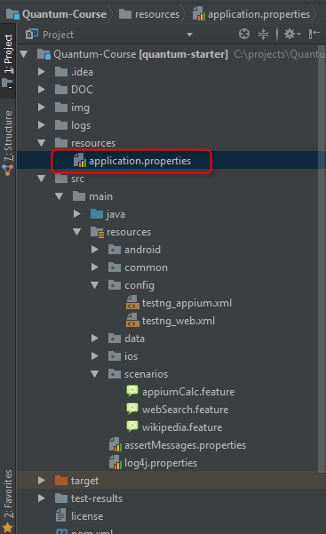
Application Properties
This is where you configure general settings for Quantum.
Perfecto Credentials
Connection info
Driver Plugin
Notes:
We now want to run our scripts and for that we need to do 2 things:
Define our credentials and cloud in the app properties.
Define our test inside testing
Lets start with the app properties Here I put in my info and I only need to do it once.
All the other parameters can stay as is without any need to change. Well revisit some of them later on.
We have our app properties filled out and we will now open the TestNG file.

Slide 19
Digging Deeper – Running with TestNG
Quantum includes TestNG for execution management
All standard TestNG parameters apply
TestNG provides methods for test management by
dividing the preparation,
test and cleanup methods
Parallel Execution
Notes:
TestNG is an automation execution framework we have included in Quantum. In a nutshell, it defines the test we want to run and on which devices.
TestNG is a testing framework developed in the lines of JUnit and NUnit, however it introduces some new functionalities that make it more powerful and easier to use.
TestNG is designed to cover all categories of tests − unit, functional, end-to-end, integration, etc., and it requires JDK 5 or higher.
In this sample, we have 2 tests, one for Android and one for iOS.
In each test we refer to the tag inside the scenario – that is the test that will be run. We also refer to the type of Device we want to run. This looks a bit different but is actually the same Selenium capabilities you are familiar with.
We have a test to run, we have a device to run on. We’re good to go, let’s execute the script.

Slide 20
How does it work?
Let's look at our TestNG configuration in Quantum which we used to run the scenario.
The format is a suite that includes tests
The include node defines the tests to run
Perfecto capabilities define the device to use
The suite can be run in parallel
Each run on a device is a test e.g. the same test on Android & iOS is 2 tests that can be run in parallel.
The group annotation points to the scenario to run
Notes:
Open the file and go over the items in the slide, explain the items.
Configure the file to run the Wikipedia test in parallel
Then add the google web search sample and have that run as well.
The class used provides the Gherkin support and should not be changed, it is required for all tests.
Use the annotation in the Wikipedia test. Note that the feature annotation runs the entire file while a scenario annotation runs just that scenario.
We can follow the execution in the IDE console and in the device dashboard.
The dashboard is available through the browser or inside the IDE by installing the Perfecto plugin.
We can see in the consoles each step being excuted.
The script has ended and we get a direct link to the report where we can see the entire run and also download a PDF or the video if we need to.

Slide 21

Try it out yourself
We need a volunteer to:
Define the application properties
Create a feature file and annotate
Create Scenario that:
Goes to https://www.w3schools.com/
Validates page loads
Selects Learn Xpath
Validates page load
We'll use predefined steps just like before
Configure TestNG
Notes:
Give this around 15 minutes.
This is the assignment so there is no need to complete it, just confirm they get the basic idea.

Slide 22

4. Assignment & Resources

Slide 23
Finish your first script
We need a volunteer to:
Define the application properties
Create a feature file and annotate
Create Scenario that:
Goes to https://www.w3schools.com/
Validates page loads
Selects Learn HTML
Validates page load
We'll use predefined steps just like before
Configure TestNG
Notes:
Give this around 15 minutes.
This is the assignment so there is no need to complete it, just confirm they get the basic idea.

Slide 24
Resources
Gherkin
https://github.com/cucumber/cucumber/wiki/Gherkin
TestNG –
http://testng.org/doc/documentation-main.html
Quantum - https://github.com/Project-Quantum/Quantum-Starter-Kit/
Perfecto Developer Site - http://developers.perfectomobile.com/
Training Course - https://github.com/Project-Quantum/Training-Course
Assignments - https://github.com/Project-Quantum/TrainingAssignments

